Slide 1
NEGATIVE SYMPTOMS OF SCHIZOPHRENIA
The negative symptoms of schizophrenia are more subtle and are the most damaging to the client’s quality of life.
They are:-(5As)
Affective flattening
Alogia
Avolition/apathy
Anhedonia/associality
Attention deficit
The symptoms of schizophrenia usually become apparent during adolescence or early adulthood (15-25 for men, 25-35 for women).
Paranoid schizophrenia has a later onset.

Slide 2
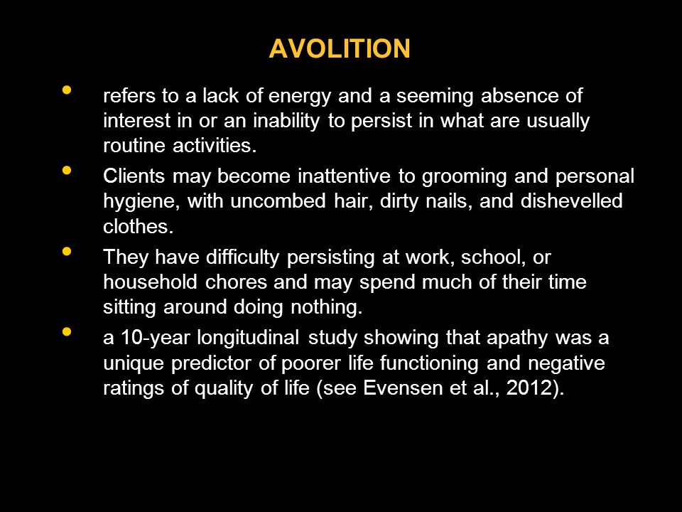

Slide 3

AVOLITION

Slide 4

AVOLITION

Slide 5

AVOLITION CONT…

Slide 6


Slide 7

ANHEDONIA

Slide 8
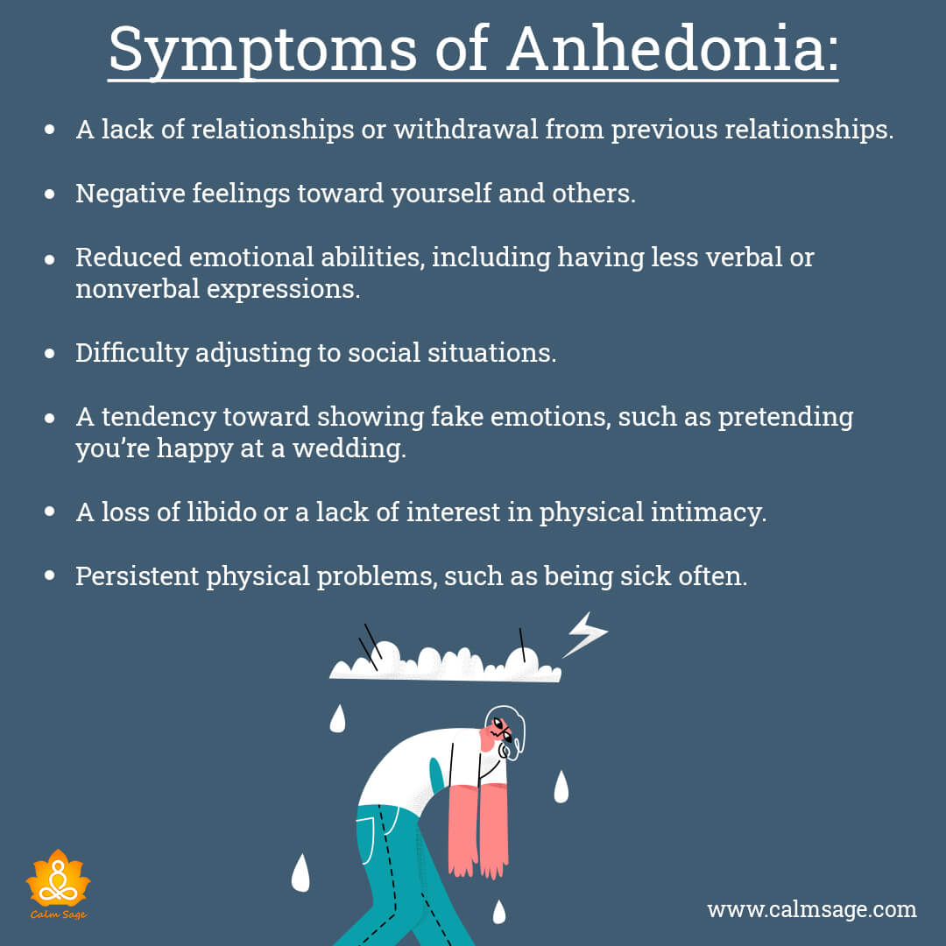
ANNEHEDONIA cont.…

Slide 9

ANNEHEDONIA cont.…

Slide 10

ANNEHEDONIA cont.…

Slide 11

ANNEHEDONIA cont.…

Slide 12

AFFECTIVE FLATENING

Slide 13
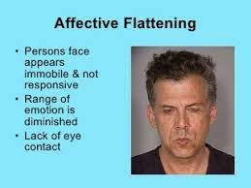

Slide 14

AFFECTIVE FLATENING CONT…

Slide 15

AFFECTIVE FLATENING CONT…

Slide 16

APATHY/ ATTENTION DEFICIT

Slide 17

ATTENTION DEFICIT

Slide 18
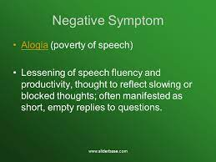
ALOGIA

Slide 19
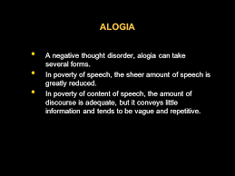

Slide 20
